Slide 1
Project Assignment 2 Power BI
Project on Sales DATA
Satyajit HEmbram

Slide 2
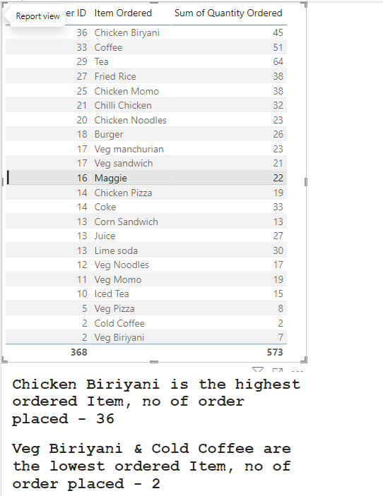
Which item is sold the most and which item is sold the least?
The item which is sold the most is Chicken Biriyani and the item which is sold the least is Chicken Biriyani and Cold Coffee.

Slide 3
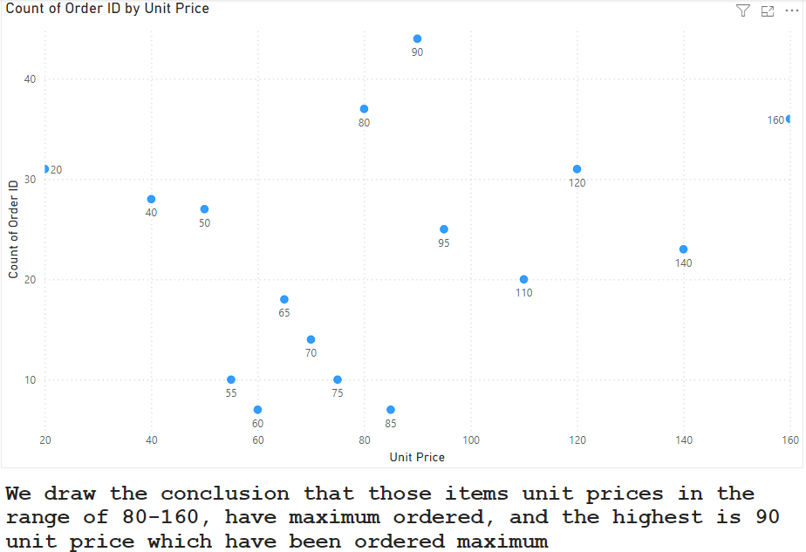
Are more units ordered against lower-priced items or higher-priced items in a single order?
The items which has unit prices in the range of 80-100, have maximum orders.

Slide 4
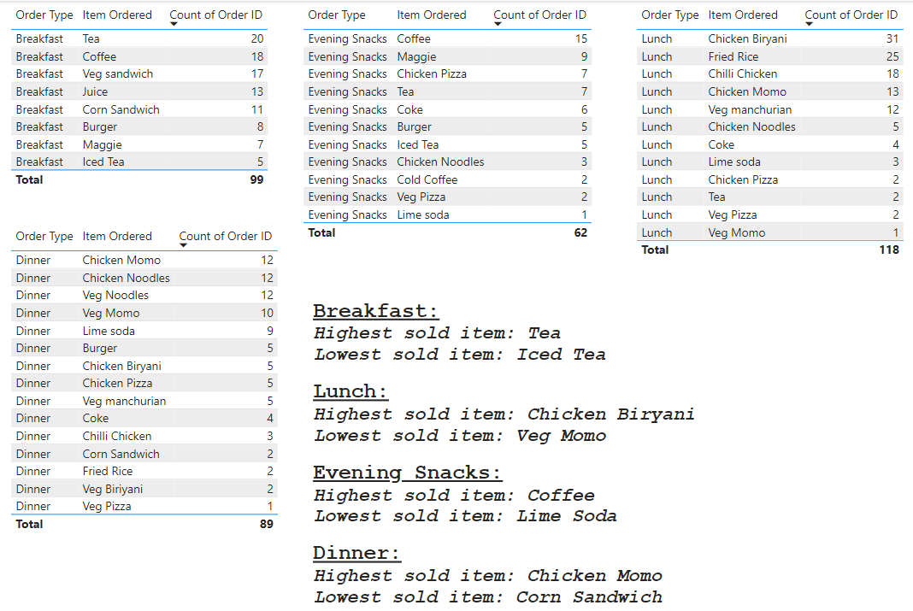
What items are sold more and what items are sold less in what type of meal?
In breakfast sold less are Iced tea and sold more is Tea. In lunch sold less are veg Momo and sold more is Chicken Biriyani. In evening snacks sold less are lime soda and sold more is Coffee. In dinner sold less is corn sandwich and sold more is Chicken Momo.

Slide 5
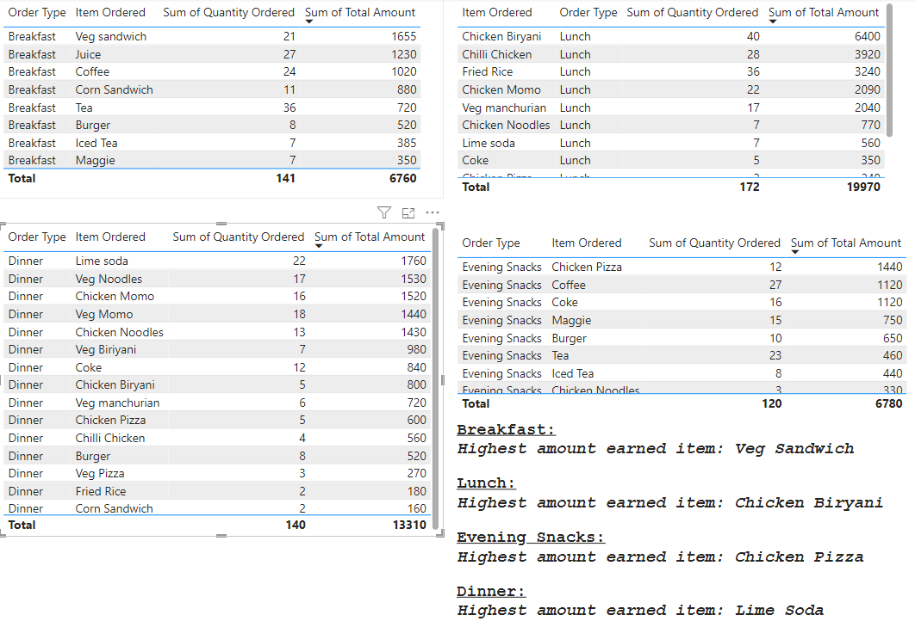
Sale of which items in what type of meal generate a greater amount of sales?

Slide 6
Should the company continue offering all items at different times of the day?
Chicken Biryani:
Continue offering during lunch and dinner as it is popular during both times, especially lunch.
Coffee:
Continue offering during breakfast and evening snacks as there is a consistent demand.
Veg Momo:
Evaluate whether it is profitable to continue offering Veg Momo during dinner given the limited number of orders (3 orders).
Lime Soda:
Evaluate whether it is profitable to continue offering Lime Soda during dinner given the limited number of orders (2 orders).
Additional Considerations
Customer Feedback: Collect feedback from customers to understand their preferences and satisfaction with the current menu and timings.
Profit Margins: Assess the profit margins for each item to ensure that even items with lower demand are contributing positively to the overall revenue.
Seasonal Trends: Consider if there are seasonal trends that might affect the demand for certain items at different times of the day.
By analyzing customer preferences and profitability, the company can make an informed decision about whether to continue offering all items at different times of the day.

Slide 7
Actionable insights from the analysis for cost-cutting and improving the profit
Continue offering Chicken Biryani during lunch and dinner; introduce promotions for lunch.
Maintain Coffee during breakfast and evening snacks; introduce loyalty programs for coffee.
Assess profitability of Veg Momo and Lime Soda; consider removing or offering as limited-time menu items if not profitable.
Optimize inventory management to reduce food wastage and better predict demand.
Adjust staff schedules to optimize labor costs during low-demand times.
Introduce new items or limited-time offers based on customer feedback and demand patterns.
Implement targeted marketing campaigns and bundle deals to increase average order value.
Develop customer loyalty programs to retain frequent customers and offer incentives.
Enhance the digital ordering experience to highlight popular items and current promotions.
By following these actionable insights, the company can cut costs, improve profit margins, and enhance overall customer satisfaction.

Slide 8
Thank you

